Slide 1
Unit-I
By Neha Gulati

Slide 2
Overview
Java Programming:
Introduction
Data types
Access specifiers
Operators
Control statements
Arrays.
Classes:
Fundamentals
Objects
Methods
Constructors.
Inheritance:
Super class
Sub class
this and super operator
Method overriding
Use of final
Packages
Abstract class
Interface.
Polymorphism:
Method overloading
Constructor overloading

Slide 3
Introduction
Java is an object oriented programming language that makes you do anything you can do with any other programming language.
Java is related to C++ which is direct descendent of C. Much of its characteristics java derive from these two languages.
Java derives its syntax from C, and its OOPs features were influenced by C++.
Primary motivation behind java was need of platform independent language.
Java
C
C
C++

Slide 4
History
Java is a general purpose, object oriented programming language platform developed by Sun Microsystems in 1991, originally called “Oak”, but renamed “java” in 1995.
Java was conceived by James Gosling, Patrick Naughton, Chris Warth, Ed frank and Mike Sheridan at Sun Microsystems.
The idea is to create a platform independent language that could be used to produce code that would run on a variety of CPUs under differing environments.
It is designed for the development of software for consumer electronics devices like TV,VCRs, toasters and such other electronic machine.
This new language is based on C and C++ but removed features of C and C++ that were considered as problems in these languages and this makes java reliable , simple and robust language.
Java is not replacement of C++, They both are designed to solve different set of problems , so can coexist for many years.
Most striking features of java is “Platform neutral” language. Java is first programming language that is not tied to any particular hardware, OS or platform. Programs developed in java can be executed anywhere on any system.

Slide 5
Java vs C++
C++ is platform dependent but java is platform independent
No More header files, Typedefs, Defines, or Preprocessor -Packages
No More Structures or Unions –Instance variables, No Enums
No More Multiple Inheritance but can be achieved using interfaces
Java does not support global variable
No More Goto Statements
No More Operator Overloading
No More Pointers
Java does not have template class as in C++
Java had replaced the destructor function with a finalize() function.

Slide 6
Java Features
Java is simple, small and familiar :
Because java inherits the C/C++ syntax and many of OOPS features of C++.
Java does not use pointers, preprocessor header files, goto statement and many more.
It also eliminates operator overloading and multiple inheritance.
It is modeled on C and C++ , so syntax is familiar.
Complied and Interpreted:
Java is two stage system that combines both compilation and interpretation.
Firstly java compiler translate source code into bytecode instruction, then java interpreter converts bytecode into machine code and run java program.
Object Oriented:
Java is true object oriented.
All program code and data reside within objects and classes.
Even the main function is inside a class.

Slide 7
Contd…
Platform Independent and Portable:
Java programs can be easily moved from one computer system to another, anywhere and anytime.
Changes in OS, processor and system resources will not force and changes in java program. Why?
Because:
Java compiler generates bytecode not machine language which is machine independent.
Size of primitive data types are machine independent.
Java is secure and robust:
Java program is secure by confining a java program to java execution environment and not allowing it access to other parts of the computer.
Java programs are robust as they are build for multiplatform environment. Moreover a program is said to be robust if it handles memory management and exception condition.

Slide 8
Contd…
Java is distributed :
Java is distributed because the program of java is compiled onto one machine can be easily transferred to machine and executes them on another machine. So java is specially designed for internet users which uses the Remote Computers for executing the programs on local machine after transferring the programs from remote computers or either from internet.
Java is multithreaded:
Means handling multiple tasks simultaneously. This means we need not wait for the application to finish one tasks before beginning another.
Java is dynamic:
Java is capable of dynamically linking in new class libraries , methods and objects. Java can also determine the type of class through a query, making it possible to either dynamically link or abort the program, depending on the response.

Slide 9
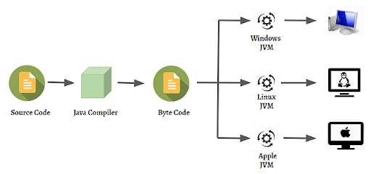
Why java is platform independent?

Slide 10
Working of Java
Java solves the problem of platform-independence by using byte code.
The Java compiler does not produce native executable code for a particular machine like a C compiler would. Instead it produces a special format called byte code.
Java byte code is exactly the same on every platform.
This byte code fragment means the same thing on a Solaris workstation as it does on a Macintosh.
Java programs that have been compiled into byte code still need an interpreter to execute them on any given platform.
The interpreter reads the byte code and translates it into the native language of the host machine on the fly.
Since the byte code is completely platform independent, only the interpreter and a few native libraries need to be ported to get Java to run on a new computer or operating system.
The rest of the runtime environment including the compiler and most of the class libraries are written in Java.
All these pieces, the javac compiler, the java interpreter, the Java programming language, and more are collectively referred to as Java.

Slide 11
Bytecode
The key that solves both security and portability problems is the Bytecode, output of java compiler which is not executable code.
It is highly optimized set of instructions designed to be executed by the java runtime system, which is called the java Virtual Machine(JVM). JVM is an interpreter for bytecode.
Translating a java program into bytecode makes it much easier to run a program in a wide variety of environments because only the JVM needs to be implemented for each platform.
Once a runtime package exists for given system, any java program can run on it.
Although the details of JVM will differ from platform to platform , all understand the same java bytecode. Thus , the execution of bytecode by the JVM is the easiest way to create truly portable programs.

Slide 12
Contd…
The fact that a java program is executed by JVM also helps to make it secure because the JVM is in control, it contain the program and prevent it from generating side effects outside the system.
When a program is complied to an intermediate form and the interpreted by a virtual machine, it runs slower than it would run if complied to executed code.
But in case of java the difference is not so great because bytecode is highly optimized, the use of bytecode enables the JVM to execute programs much faster that you might expect.

Slide 13
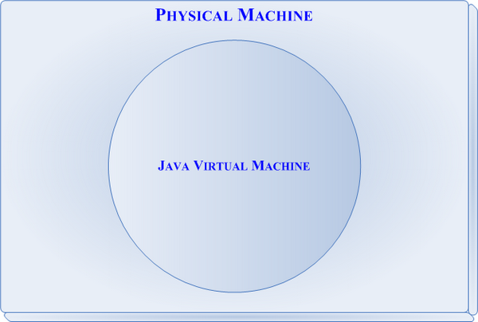
Java Virtual Machine (JVM)
JVM (Java Virtual Machine) is an abstract machine. It is called a virtual machine because it doesn't physically exist.
It is a specification that provides a runtime environment in which Java bytecode can be executed.
It can also run those programs which are written in other languages and compiled to Java bytecode.

Slide 14
Contd…
JVMs are available for many hardware and software platforms. JVM, JRE, and JDK are platform dependent because the configuration of each operating system is different from each other.
However, Java is platform independent.
The JVM performs the following main tasks:
Loads code
Verifies code
Executes code
Provides runtime environment

Slide 15
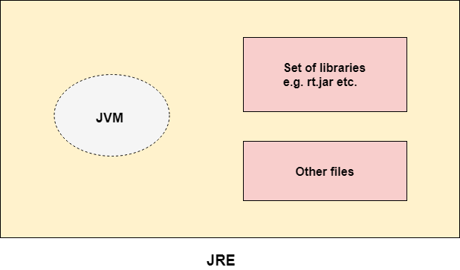
Java Runtime Environment (JRE)
JRE is an acronym for Java Runtime Environment. It is also written as Java RTE.
The Java Runtime Environment is a set of software tools which are used for running Java applications.
It is used to provide the runtime environment. It is the implementation of JVM.
It physically exists.
It contains a set of libraries + other files that JVM uses at runtime.

Slide 16
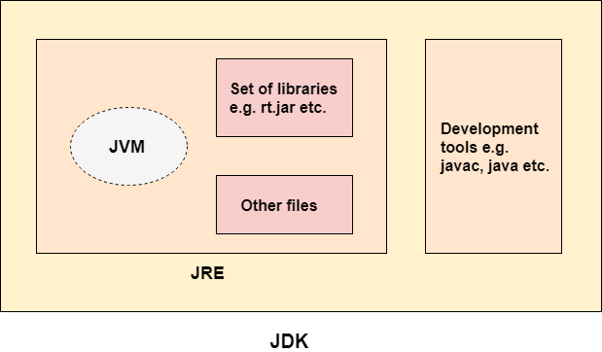
Java Development Kit (JDK)
JDK is an acronym for Java Development Kit. The Java Development Kit (JDK) is a software development environment which is used to develop Java applications and applets.
It physically exists.
It contains JRE + development tools.
The JDK contains a private Java Virtual Machine (JVM) and a few other resources such as an interpreter/loader (java), a compiler (javac), an archiver (jar), a documentation generator (Javadoc), etc. to complete the development of a Java Application.

Slide 17
Difference between JDK, JRE, and JVM
To develop and run a java program we need the environment JDK.
Only to run a java program we need JRE environment.
So, I can say as a software developer I need to develop JAVA application, I need JDK but on the client side, he/she needs JRE only as it has to run the application not develop.
JVM is responsible to run java programs line by line as an interpreter.

Slide 18
Java Architecture
Java's architecture arises out of four distinct but interrelated technologies:
the Java programming language
the Java class file format
the Java Application Programming Interface
the Java virtual machine
When you write and execute java program , all these technologies are used in following way:
You write source file in java programming language.
Java compiler(javac) compile java source file into java class file.
Your program accesses system resources by calling methods in the classes that implements java API , this is done by invoking methods in class file that implements java API.
JVM is responsible to execute class files generated by java compiler.
Together JVM and java API form a platform for which all java programs are executed.

Slide 19
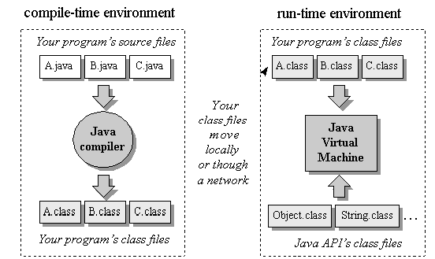
Java Programming Environment

Slide 20
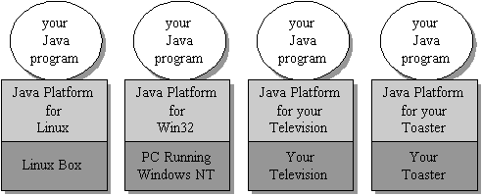
Java Program run on top of Java Platform
the combination of the Java virtual machine and Java API is called the Java Platform.
Java programs can run on many different kinds of computers because the Java Platform can itself be implemented in software.
Java program can run anywhere the Java Platform is present.

Slide 21
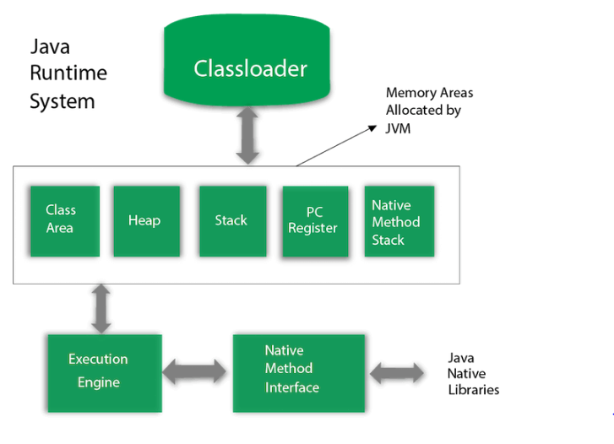
JVM Architecture
JVM is the heart of Java architecture and supports all three features of java:
platform independence, security and network mobility.

Slide 22
explanation
Class Loader Sub-System: It performs the task in a sequential way:
It loads a class file.
It checks the correctness of the class file. If any one has manipulated the class file, then the class file can not be executed.
It allocates the memory for static variables.
It sets the default value of all static variable.
Method Area:
It is a logical memory component of JVM.
This logical section of memory holds the information about classes and interfaces.
Static variables are treated as class variables, because they take memory from method area.

Slide 23
Contd…
Heap:
When object or array is created, memory is allocated to them from heap.
JVM through the use of new operator allocates memory from the heap for an object.
The JVM has a daemon thread known as Garbage Collector whose task is to free those objects from heap whose reference is not alive in stack.
Java Stack:
Method codes are stored inside method area.
For execution, a method needs memory because of local variables and the arguments it has taken.
This purpose is fulfilled by java stack.
Program Counter:
It keeps track of the sequence of the program.
PC register holds the address of the instructions to be executed next.

Slide 24
Contd…
Native Method Stack:
When a java application invokes a native method, that application does not only use java stack but also use the native method stack for the execution of native methods.
The libraries required for the execution of native methods are available to the JVM through Java Native Interface.
Execution Engine:
Generate and executes the java byte code.
It contains an interpreter and Just In Time compiler.
Java Native interface:
JNI is used when the programmer has already developed the code in C/ C++ and wishes to make it accessible to java code.
JNI never imposes any restriction on JVM.
JVM can add support to JNI without affecting other parts of virtual machine.
Native methods accesses JVM features by calling JNI functions.

Slide 25
Basic Java Program

Slide 26
Path and Classpath in JAVA
PATH:
PATH environment variable is used by operating system to find any binary or command typed in shell, this is true for both Windows and Linux environment.
It is an environment variable which is used to locate JDK binaries like "java" or "javac" command used to run java program and compile java source file.
CLASSPATH:
It is only used by Java Class Loaders to load class files.
CLASSPATH environment variable is used by System or Application ClassLoader to locate and load compile Java bytecodes stored in .class file.

Slide 27
How to set path in java?
There are two ways to set the path in Java:
Temporary
Permanent
How to set the Temporary Path of JDK in Windows?
To set the temporary path of JDK, you need to follow the following steps:
Open the command prompt
Copy the path of the JDK/bin directory
Write in command prompt: set path=copied_path
For Example:
set path=C:\Program Files\Java\jdk1.6.0_23\bin

Slide 28
Contd…
How to set Permanent Path of JDK in Windows?
For setting the permanent path of JDK, you need to follow these steps:
Go to MyComputer properties -> advanced tab -> environment variables -> new tab of user variable -> write path in variable name -> write path of bin folder in variable value -> ok -> ok -> ok

Slide 29
Java code execution
Java code can be executed using notepad and command prompt.
Java code cab be executed using any IDE Eclipse, NetBeans.

Slide 30
Getting Started with Java Programming
A Simple Java Application
Compiling Programs
Executing Applications

Slide 31
Entering a Program
For most of the programs the name of the file that holds the source code to a program is immaterial. However, this is not the case with java. the first thing that you must learn about java is that name you give to a source file is very important.
In java a source file is a compilation unit. It is a text file that contains one or more class definitions. The java compiler requires that a source file use the .java filename extension.
In java all code must reside inside a class. By convention, the name of that class should match the name of the file that holds the program. You should also make sure that the capitalization of the filename matches the class name. the reason for this is that java is case sensitive . At this point , the convention that filename correspond to class names may seem arbitrary. However, this convention makes it easier to maintain and organize your program.

Slide 32
Contd…
To compile the program use javac filename. java.
The javac compiler creates a file called filename.class that contains the byte code version of the program. As we know that java byte code is the intermediate representation of your program that contains instructions that JVM (Java Virtual Machine) will execute. Thus, the output of the javac is not code that can be directly executed.
To run the program you have to use java application launcher , called (JVM). For execution use: java filename

Slide 33
Rules for writing java program
Always start with class keyword
After type the program, save the file in the name of the class. ( ex: test.java)
Source file name and class name should be same(even case also).
Extension must be .java
Compile the file using javac compiler
C:\>javac test.java
Running we must use java interpreter
C:\>java test

Slide 34
Creating and Compiling Programs
On command line for compilation
javac Welcome.java
On command line for execution
java Welcome

Slide 35
First Java Program
1.class test
2./* this is a first program */
3. {
4. public static void main (String args[])
5. {
6. system.out.println(“welcome to the world of java”);
7. }
8. }
save this file as test.java
To compile:
javac test.java
To execute:
java test

Slide 36
Details for the program
First line uses to declare a new class is being defined.
Second –Comments. We can use
// - Single line Comment
/* ……… */ -multiple line comment
Fourth line:
public – It is an access specifier. main() must be declared as public, since it must be called by code outside of its class when the program is started.
static – to be called without creating the object of that class. This is necessary since main() is called by JVM before any object are made.
void – simply tells the compiler that main does not return any value.
main() – Line at which the program will begin executing. Main() is different from main(), since java is case sensitive.
String args[] –Parameter named args is passing to main method. It is an array of instances of the class String. In normal case args receive any command line arguments present when the program is executed.

Slide 37
Contd…
Sixth line – Output to the screen.
System – class
out – static member of system class. represents output stream that is connected to the console.
println() – method

Slide 38
What is system.out.println() ?
System.out.println prints the argument passed, into the System.out which is generally stdout.
System – is a final class and cannot be inherited. As per javadoc, “…Among the facilities provided by the System class are standard input, standard output, and error output streams;
out – is a static member field of System class and is of type PrintStream. Its access specifiers are public final. This gets instantiated during startup and gets mapped with standard output console of the host. This stream is open by itself immediately after its instantiation and ready to accept data.
println – println prints the argument passed to the standard console and a newline. There are multiple println methods with different arguments (overloading). Every println makes a call to print method and adds a newline. print calls write() and the story goes on like that.

Slide 39
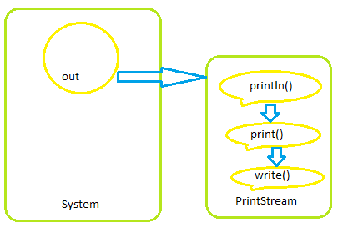

Slide 40
Data input in java
There are various ways to accept input from user in java program, one of the easiest ways is using scanner class of until package.
This class has following functions to accept different types of data from user:
Public String next() Finds and returns the next complete token from this scanner.
Public boolean nextBoolean() Scans the next token of the input into a boolean value and returns that value.
Public byte nextByte() Scans the next token of the input as a byte.
Public double nextDouble() Scans the next token of the input as a double.
Public float nextFloat() Scans the next token of the input as a float.
Public int nextInt() Scans the next token of the input as an int.
Public String nextLine() Advances this scanner past the current line and returns the input that was skipped.
Public long nextLong() Scans the next token of the input as a long.
Public short nextShort() Scans the next token of the input as a short.

Slide 41
Data Types
Data types specify the different sizes and values that can be stored in the variable. There are two types of data types in Java:
Primitive data types: The primitive data types include boolean, char, byte, short, int, long, float and double.
Non-primitive data types: The non-primitive data types include Classes, Interfaces, and Arrays.
Java defines eight primitive (or elemental) types of data: byte, short, int, long, char, float, double, and boolean.
These can be put in four groups:
Integers: This group includes byte, short, int, and long, which are for whole valued signed numbers.
Floating-point numbers: This group includes float and double, which represent numbers with fractional precision.
Characters: This group includes char, which represents symbols in a character set, like letters and numbers.
Boolean: This group includes Boolean, which is a special type for representing true/false values

Slide 42
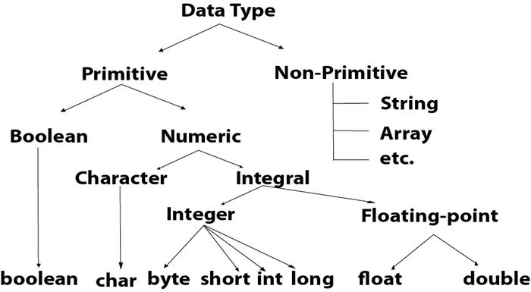

Slide 43
DATA Types
INTEGERS
Java defines four integer types: byte, short, int, and long. All of these are signed, positive and negative values.
long 64, int 32, short 16, byte 8
BYTE
The smallest integer type is byte. This is a signed 8-bit type that has a range from –128 to 127.
Variables of type byte are especially useful when you’re working with a stream of data from a network or file. They are also useful when you’re working with raw binary data that may not be directly compatible with Java’s other built-in types.

Slide 44
Contd…
short
short is a signed 16-bit type. It has a range from –32,768 to 32,767. It is probably the least-used Java type, since it is defined as having its high byte first
int
The most commonly used integer type is int. It is a signed 32-bit type that has a range from –2,147,483,648 to 2,147,483,647. In addition to other uses, variables of type int are commonly employed to control loops and to index arrays.
long
long is a signed 64-bit type and is useful for those occasions where an int type is not large enough to hold the desired value.
The range of a long is quite large. This makes it useful when big, whole numbers are needed.

Slide 45
Contd…
Floating-Point Types
Floating-point numbers, also known as real numbers, are used when evaluating expressions that require fractional precision.
float
The type float specifies a single-precision value that uses 32 bits of storage.
Single precision is faster on some processors and takes half as much space as double precision, but will become imprecise when the values are either very large or very small
double
Double precision, as denoted by the double keyword, uses 64 bits to store a value.
Double precision is actually faster than single precision on some modern processors that have been optimized for high-speed mathematical calculations.
All math functions, such as sin( ), cos( ), and sqrt( ), return double values.

Slide 46
Contd…
Characters
In Java, the data type used to store characters is char. However, C/C++ programmers beware: char in Java is not the same as char in C or C++.
In C/C++, char is an integer type that is 8 bits wide. This is not the case in Java.
Instead, Java uses Unicode to represent characters. Unicode defines a fully international character set that can represent all of the characters found in all human languages, in Java char is a 16-bit type.
Booleans
Java has a simple type, called boolean, for logical values. It can have only one of two possible values, true or false.

Slide 47
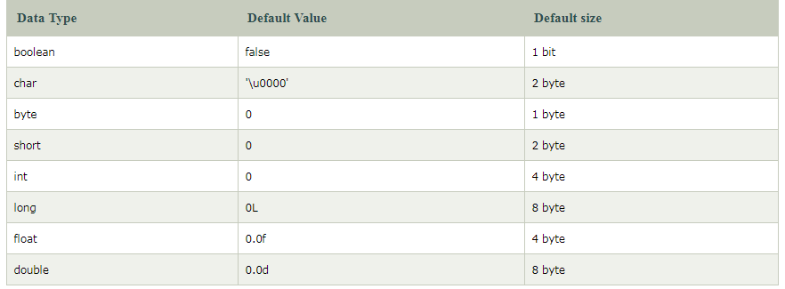
Default values of data types

Slide 48
Why char uses 2 byte in java and what is \u0000 ?
It is because java uses Unicode system not ASCII code system. The \u0000 is the lowest range of Unicode system.
Why java uses Unicode System?
Before Unicode, there were many language standards: ASCII ,ISO 8859-1,KOI-8,GB18030 and so on.
This caused two problems:
A particular code value corresponds to different letters in the various language standards.
The encodings for languages with large character sets have variable length. Some common characters are encoded as single bytes, other require two or more byte.
To solve these problems, a new language standard was developed i.e. Unicode System. In Unicode, character holds 2 byte, so java also uses 2 byte for characters.
lowest value:\u0000, highest value:\uFFFF

Slide 49
Java Variables
Variable is name of reserved area allocated in memory. In other words, it is a name of memory location.
It is a combination of "vary + able" that means its value can be changed.
int data=10;//Here data is variable

Slide 50
Declaring and initializing a variable:
DECLARING VARIABLES
In Java, all variables must be declared before they can be used. The basic form of a variable declaration is shown here:
type identifier [ = value][, identifier [= value] ...] ;
The type is one of Java’s atomic types, or the name of a class or interface. The identifier is the name of the variable. You can initialize the variable by specifying an equal sign and a value.
Some examples:
int a, b, c; // declares three ints, a, b, and c.
int d = 3, e, f = 5; // declares three more ints, initializing d and f.
byte z = 22; // initializes z.
double pi = 3.14159; // declares an approximation of pi.
char x = 'x'; // the variable x has the value 'x'.

Slide 51
Contd…
Dynamic Initialization:
Initialization is the process of providing value to a variable at declaration time.
A variable is initialized once in its life time. Any attempt of setting a variable's value after its declaration is called assignment.
To use a local variable you have to either initialize or assign it before the variable is first used. But for class members, the compulsion is not so strict.
If you don't initialize them then compiler takes care of the initialization process and set class members to default values.
Java allows variables to be initialized dynamically, using any expression valid at the time the variable is declared.

Slide 52
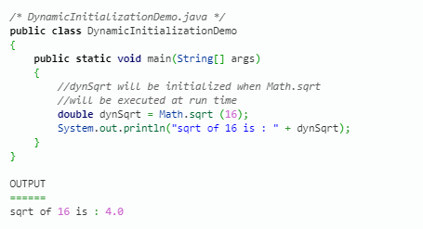
Contd…
Example- Here variable dynSqrt is initialized dynamically .The program uses another of Java’s built-in methods, sqrt( ), which is a member of the Math class, to compute the square root of its argument.

Slide 53
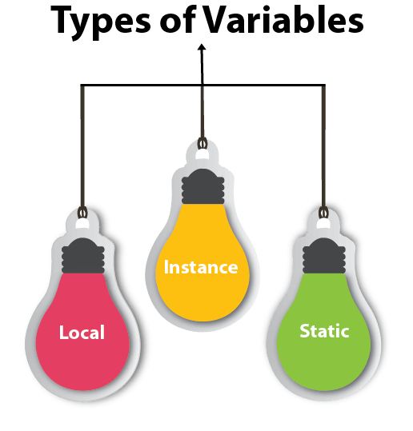
Types of Variables
There are three types of variables in java:
local variable
instance variable
static variable

Slide 54
Local variables
Local variables are declared in methods, constructors, or blocks.
Local variables are created when the method, constructor or block is entered and the variable will be destroyed once it exits the method, constructor, or block.
Access modifiers cannot be used for local variables.
Local variables are visible only within the declared method, constructor, or block.
Local variables are implemented at stack level internally.
There is no default value for local variables, so local variables should be declared and an initial value should be assigned before the first use.

Slide 55
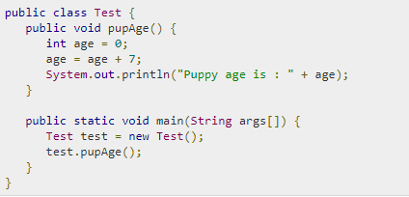
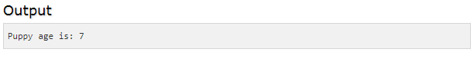
Example
Here, age is a local variable. This is defined inside pupAge() method and its scope is limited to only this method.

Slide 56
Instance Variables
Instance variables are declared in a class, but outside a method, constructor or any block.
When a space is allocated for an object in the heap, a slot for each instance variable value is created.
Instance variables are created when an object is created with the use of the keyword 'new' and destroyed when the object is destroyed.
Instance variables can be declared in class level before or after use.
Access modifiers can be given for instance variables.
The instance variables are visible for all methods, constructors and block in the class. Normally, it is recommended to make these variables private (access level). However, visibility for subclasses can be given for these variables with the use of access modifiers.

Slide 57
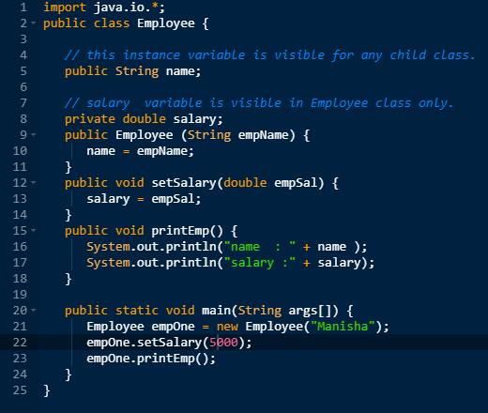
Contd…
Instance variables have default values. For numbers, the default value is 0, for Booleans it is false, and for object references it is null. Values can be assigned during the declaration or within the constructor.
OUTPUT:
name : Manisha salary :5000.0

Slide 58
Class/Static Variables
Class variables also known as static variables are declared with the static keyword in a class, but outside a method, constructor or a block.
There would only be one copy of each class variable per class, regardless of how many objects are created from it.
Static variables are rarely used other than being declared as constants. Constants are variables that are declared as public/private, final, and static. Constant variables never change from their initial value.
Static variables are stored in the static memory. It is rare to use static variables other than declared final and used as either public or private constants.
Static variables are created when the program starts and destroyed when the program stops.
Visibility is similar to instance variables. However, most static variables are declared public since they must be available for users of the class.
Default values are same as instance variables.

Slide 59
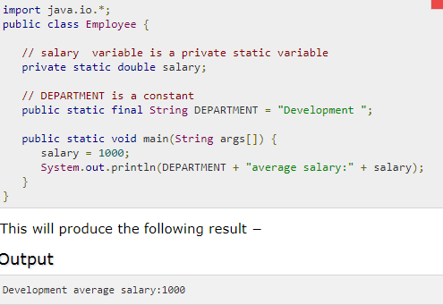
Contd…
Static variables can be accessed by calling with the class name ClassName.VariableName.

Slide 60
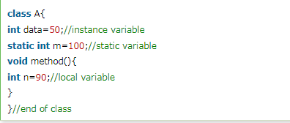
Example to understand the types of variables in java

Slide 61
Scope and Lifetime of variables
Scope of a variable refers to in which areas or sections of a program can the variable be accessed and lifetime of a variable refers to how long the variable stays alive in memory.
General convention for a variable’s scope is, it is accessible only within the block in which it is declared. A block begins with a left curly brace { and ends with a right curly brace }.
As we know there are three types of variables:
1) instance variables
2) class variables and
3) local variables
we will look at the scope and lifetime of each of them now.

Slide 62
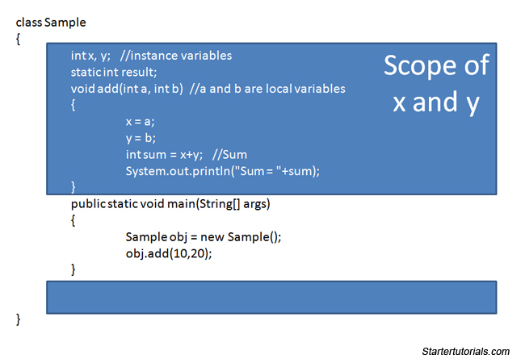
Contd…
Instance Variables:
General scope of an instance variable is throughout the class except in static methods.
Lifetime of an instance variable is until the object stays in memory.

Slide 63
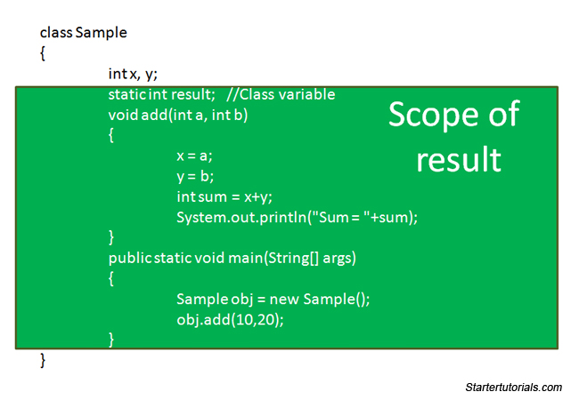
Contd…
Class Variables:
General scope of a class variable is throughout the class and the lifetime of a class variable is until the end of the program or as long as the class is loaded in memory.

Slide 64
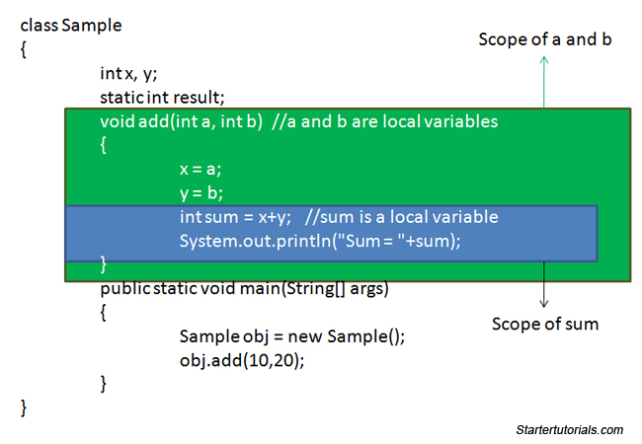
Contd…
Local Variables:
Scope of a local variable is within the block in which it is declared and the lifetime of a local variable is until the control leaves the block in which it is declared

Slide 65
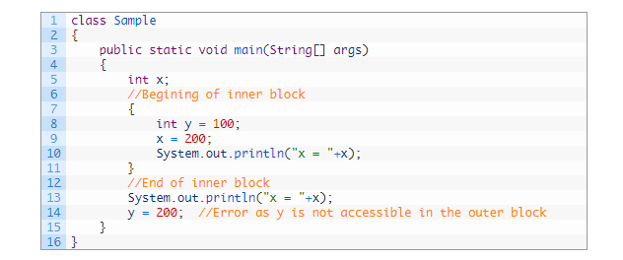
Nested scope
All the local variables in the outer block are accessible within the inner block but vice versa is not true i.e., local variables within the inner block are not accessible in the outer block. Consider the following example:
NOTE: As you can see in the above program, line 14 generates an error as the variable y is not visible in the outer block and therefore cannot be accessed.

Slide 66
Type conversion and casting
When you assign value of one data type to another, the two types might not be compatible with each other.
If the two types are compatible, then Java will perform the conversion automatically known as Automatic Type Conversion or Implicit Coversion. For example, it is always possible to assign an int value to a long variable.
However, not all types are compatible, and thus, not all type conversions are implicitly allowed. For instance, there is no conversion defined from double to byte.
Fortunately, it is still possible to obtain a conversion between incompatible types. To do so, you must use a cast, which performs an explicit conversion between incompatible types.

Slide 67
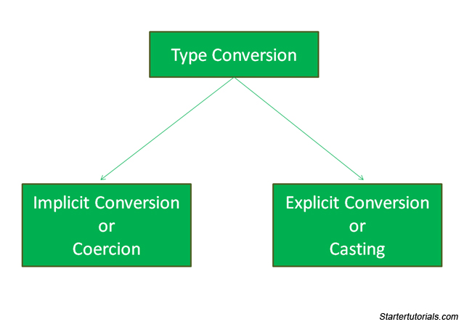

Slide 68
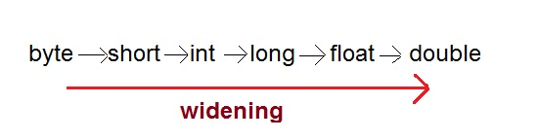
Implicit Conversion or Coercion
Implicit conversion takes place when two data types are automatically converted. This happens when:
The two data types are compatible.
When we assign value of a smaller data type to a bigger data type.
For example, Java will automatically convert a value of byte into int type in expressions since they are both compatible and int is larger than byte type.
Since a smaller range type is converted into a larger range type this conversion is also known as widening conversion. Characters can never be converted to boolean type. Both are incompatible.

Slide 69
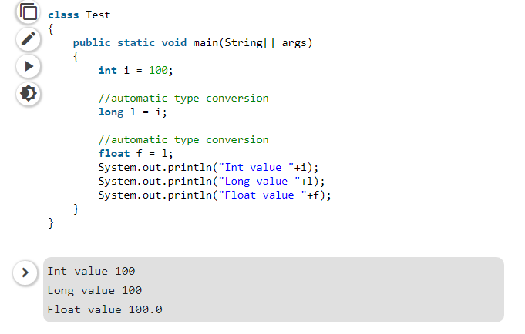
Example-

Slide 70
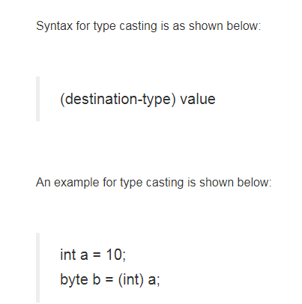
Explicit Conversion or Narrowing
There may be situations where you want to convert a value having a type of size less than the destination type size.
In such cases Java will not help you.
You have do it on your own explicitly.
That is why this type of conversion is known as explicit conversion or casting as the programmer does this manually.

Slide 71

Contd…
In the last example, I am forcing an integer value to be converted into a byte type. For type casting to be carried out both the source and destination types must be compatible with each other. For example, you can’t convert an integer to Boolean even if you force it.
In the last example, size of source type int is 32 bits and size of destination type byte is 8 bits. Since we are converting a source type having larger size into a destination type having less size, such conversion is known as narrowing conversion.
A type cast can have unexpected behavior. For example, if a double is converted into an int, the fraction component will be lost.

Slide 72
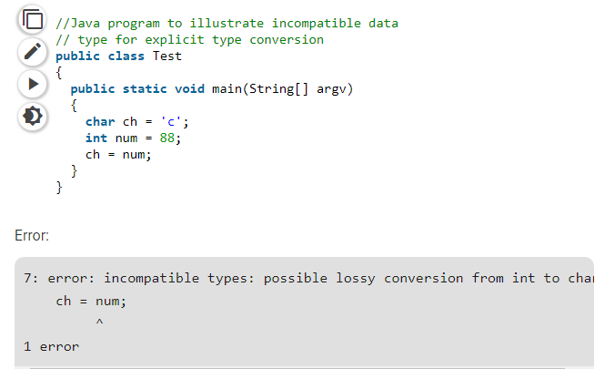
Example-

Slide 73
Example-
class Conversion {
public static void main(String args[]) {
byte b;
int i = 257;
double d = 323.142;
System.out.println("\nConversion of int to byte.");
b = (byte) i;
System.out.println("i and b " + i + " " + b);
System.out.println("\nConversion of double to int.");
i = (int) d;
System.out.println("d and i " + d + " " + i);
System.out.println("\nConversion of double to byte.");
b = (byte) d;
System.out.println("d and b " + d + " " + b);
}
}

Slide 74
Contd…
This program generates the following output:
Conversion of int to byte.
i and b 257 1
Conversion of double to int.
d and i 323.142 323
Conversion of double to byte.
d and b 323.142 67

Slide 75
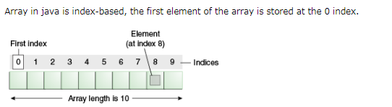
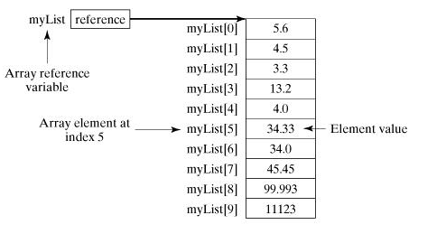
Arrays
An array is a structure that holds multiple values of the same type .
Arrays can be one dimensional or more.
The length of an array is established when the array is created (at runtime).
After creation, an array is a fixed-length structure.
An array element is one of the values within an array and is accessed by its position within the array.
Arrays can hold reference types as well as primitive types

Slide 76
Contd…
Advantages:
Code Optimization: It makes the code optimized, we can retrieve or sort the data efficiently.
Random access: We can get any data located at an index position.
Disadvantages:
Size Limit: We can store only the fixed size of elements in the array. It doesn't grow its size at runtime. To solve this problem, collection framework is used in Java which grows automatically.
Types of Array in java:
There are two types of array.
Single Dimensional Array
Multidimensional Array

Slide 77
How to create an array?(1-Dimesional)
Declare the Array
Create memory location
Put values into the memory Location
Declare the Array:
An array declaration has two components: the array's type and the array's name.
datatype arrayname[];
datatype[] arrayname;
ex : int marks[]; int[] marks;
In java it is required to allocate memory to an array using new operator.
Till declaration just array variable is there, no array exists.
For the physical allocation of memory it is required to use new operator or directly assign values to array location.
After initialization all the elements of an array will be automatically initialized to 0.
Remember we do not enter the size of arrays in the declaration.

Slide 78
Contd…
Creating Memory location:
You create an array explicitly using Java's new operator.
Arrayname = new type[];
Eg: marks = new int[10]; // create an array of integers
It is possible to combine declaration and creation in one step like :
int number = new int[5];
Initialization of Arrays:
An array initializer is a list of comma separated expressions surrounded by curly braces.
Arrayname [subscript] = value;
Marks[i] =100;
int marks[] = {70,80,56,78};

Slide 79
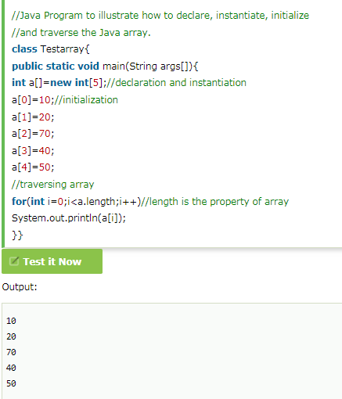
Example of 1-D Array

Slide 80
Aggregate array operations:
You can perform same operation on arrays as we do on a series of input values.
To perform an operation on all elements in an array, we use a loop to perform the operation on each element.
Example to print all elements in an array:
for(int i=0;i<arr.length;i++)
{
System.out.println(arr[i]);
}

Slide 81
Example to sort an array in ascending order
class sort
{
public static void main(String args[]) {
int number[]={100,45,78,56,72};
int len;
len=number.length;
System.out.println(“Unsorted list”);
for(int i=0;i<len;i++) {
System.out.println(“ “ + nmber[i]);
}
for(int i=0;i<len-1;i++) {
for(j=i+1;j<len;j++) {
if(number[i]>number[j]) {
int temp=number[i];
number[i]=number[j];
number[j]=temp; } } }
System.out.println(“\n Ascending order”);
for (int i=0;i<len;i++) {
System.out.println(“ “ + number[i]); }
System.out.println(“Descending order”);
for (int i=len-1;i>=0;i--)
System.out.println(“ “ + number[i]);
}
}

Slide 82
Example to sum elements of array
class SummingArrayElements
{
public static void main(String args[])
{
double total=0.0;
double []scores=new double[6];
scores[0]=12.2;
scores[1]=33.90;
scores[2]=16.00;
scores[3]=22.90;
scores[4]=11.00;
scores[5]=134.90;
for(int i=0;i<scores.length;i++)
total+=scores[i];
System.out.println(“Scores total=” + total);
}
}

Slide 83
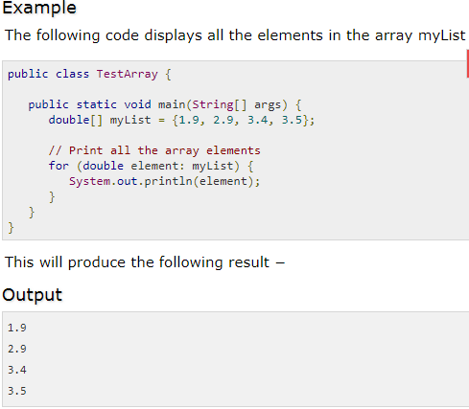
The foreach Loops
JDK 1.5 introduced a new for loop known as foreach loop or enhanced for loop, which enables you to traverse the complete array sequentially without using an index variable.

Slide 84
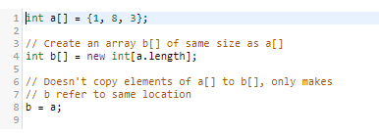
Copying arrays
Arrays are reference types, so by declaring a reference and assigning it to an existing array, you are not creating two objects, you are just creating two references that point to the same array.
Manipulation of one these objects will affect the other.

Slide 85
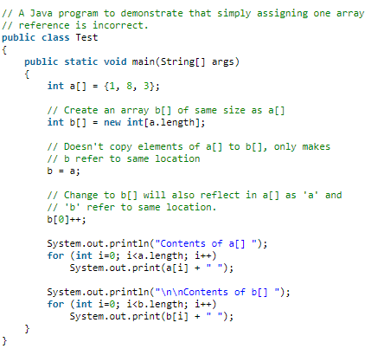
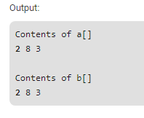
Example-

Slide 86
Otherways to make copy of an array
Iterating over an array
Using Clone()
Using System.arraycopy()

Slide 87
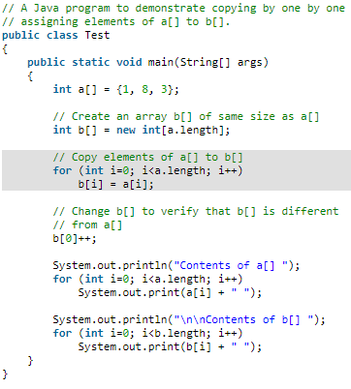
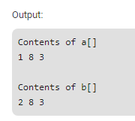
1)Iterating over an array

Slide 88
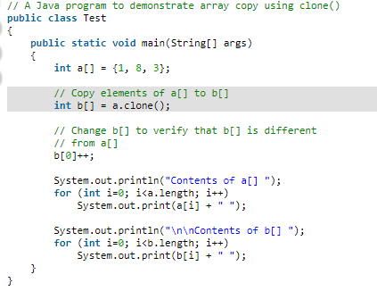
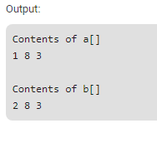
2)Using Clone()

Slide 89
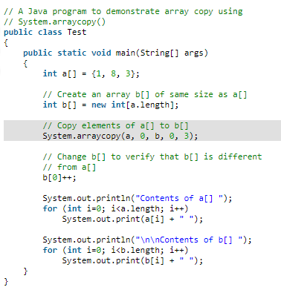
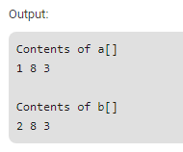
3)Using ArrayCopy()

Slide 90
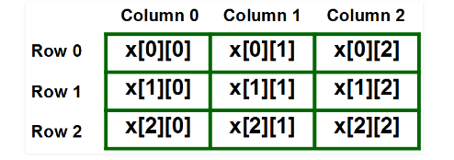
Multidimensional Array
In java multidimensional arrays are actually arrays of arrays. To declare a multidimensional array variable, specify each additional index using another set of square brackets.
int two_array [] [] = new int [4][5]
In above declared two dimensional array, left index determines row and right index determines column.
Ex : int marks[][] = new int[3][3]

Slide 91
Contd…
When you allocate memory for a multidimensional array, you need only specify the memory for the first (leftmost) dimension. You can allocate the remaining dimensions separately.
For example, this following code allocates memory for the first dimension of marks when it is declared. It allocates the second dimension manually.
int marks[][] = new int[4][];
marks[0] = new int[5];
marks[1] = new int[5];
marks[2] = new int[5];
marks[3] = new int[5];

Slide 92
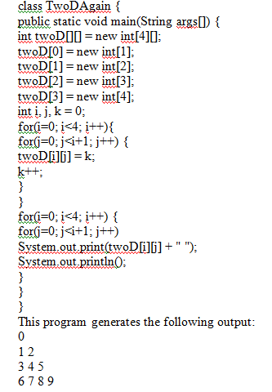
Contd…
Manually allocate differing size second dimensions.

Slide 93
Alternative array Declaration Syntax
Datatype name_of_array [ ] ;
Datatype [ ] name_of_array;
int a1[ ] = new int[3];
int [ ] a1 = new int[3];
int a1[ ][ ] = new int [4][5];
int [ ][ ]a1 = new int [3][4];
int [ ] a1,a2,a3;
int a1[ ], a2[ ],a3[ ];

Slide 94
Command Line Arguments
A command-line argument is the information that directly follows the program’s name on the command line when it is executed.
To access the command-line arguments inside a Java program is quite easy—they are stored as strings in the String array passed to main( ).
For example, the following program displays all of the command-line arguments that it is called with:

Slide 95
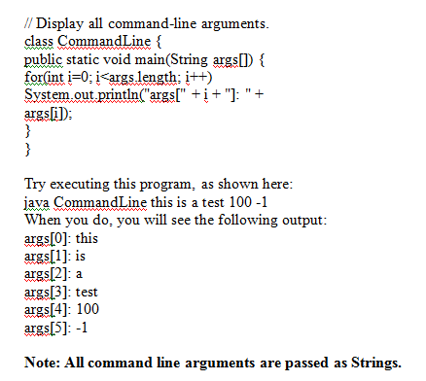
Contd…

Slide 96
Operators
Java provides a rich operator environment. Most of its operators can be divided into the following four groups:
Arithmetic
Bitwise
Relational
Logical

Slide 97
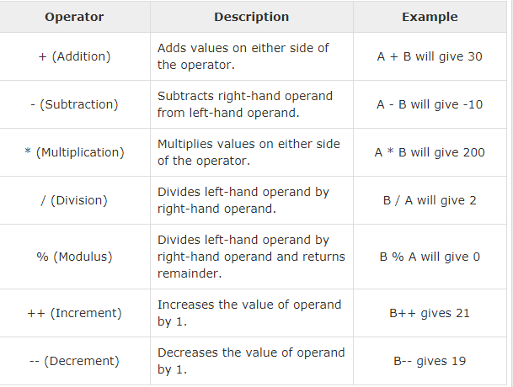
The Arithmetic Operators
Arithmetic operators are used in mathematical expressions in the same way that they are used in algebra.
The following table lists the arithmetic operators (Assume integer variable A holds 10 and variable B holds 20)

Slide 98
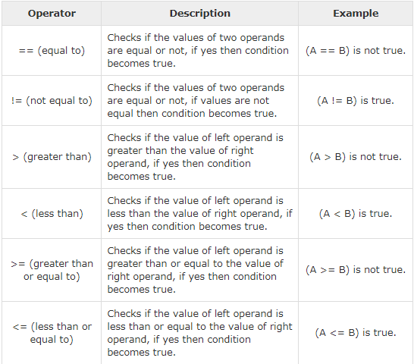
The Relational Operators
The relational operators determine the relationship that one operand has to the other. Specifically, they determine equality and ordering.
Assume variable A holds 10 and variable B holds 20

Slide 99
The Bitwise Operators
Java defines several bitwise operators, which can be applied to the integer types, long, int, short, char, and byte.
Bitwise operator works on bits and performs bit-by-bit operation. Assume if a = 60 and b = 13; now in binary format they will be as follows −
a = 0011 1100
b = 0000 1101
a&b = 0000 1100
a|b = 0011 1101
a^b = 0011 0001
~a = 1100 0011
The following table lists the bitwise operators −

Slide 100
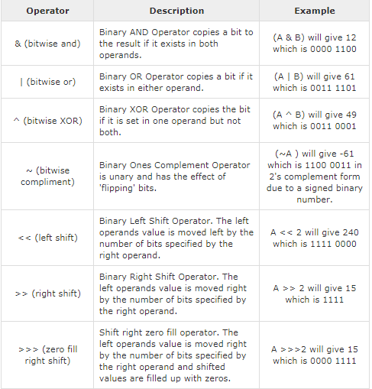
Contd…
Assume integer variable A holds 60 and variable B holds 13

Slide 101
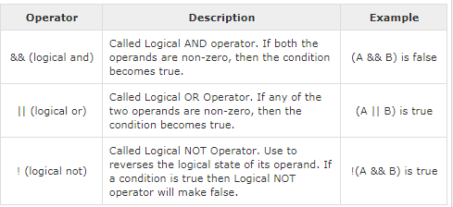
The Logical Operators
Assume Boolean variables A holds true and variable B holds false

Slide 102
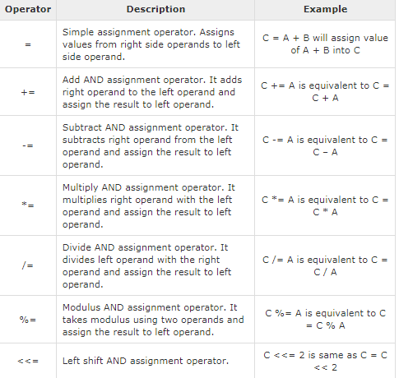
The Assignment Operators

Slide 103
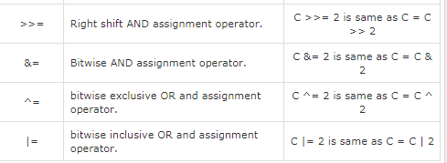
Contd…

Slide 104
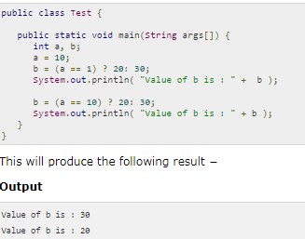
Miscellaneous Operators
There are few other operators supported by Java Language.
Conditional Operator ( ? : )
Conditional operator is also known as the ternary operator. This operator consists of three operands and is used to evaluate Boolean expressions. The goal of the operator is to decide, which value should be assigned to the variable. The operator is written as −
variable x = (expression) ? value if true : value if false

Slide 105
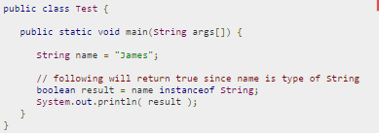
Contd…
instanceof Operator
This operator is used only for object reference variables. The operator checks whether the object is of a particular type (class type or interface type). instanceof operator is written as −
( Object reference variable ) instanceof (class/interface type)
If the object referred by the variable on the left side of the operator passes the IS-A check for the class/interface type on the right side, then the result will be true.
Following is an example

Slide 106

Contd…

Slide 107

Precedence of Java Operators

Slide 108
Control Statements
In Java, control statements can be divided into the following three categories:
Selection Statements
Iteration Statements
Jump Statements

Slide 109
Selection Statements
Selection statements allow you to control the flow of program execution on the basis of the outcome of an expression or state of a variable known during runtime.
Selection statements can be divided into the following categories:
The if and if-else statements
The if-else statements
The if-else-if statements
The switch statements

Slide 110

The if statements
The first contained statement (that can be a block) of an if statement only executes when the specified condition is true.
If the condition is false and there is not else keyword then the first contained statement will be skipped and execution continues with the rest of the program.

Slide 111

The if-else statements
In if-else statements, if the specified condition in the if statement is false, then the statement after the else keyword (that can be a block) will execute.

Slide 112
The if-else-if statements
This statement following the else keyword can be another if or if-else statement. That would looks like this: if(condition) statements; else if (condition) statements; else if(condition) statement; else statements; Whenever the condition is true, the associated statement will be executed and the remaining conditions will be bypassed. If none of the conditions are true then the else block will execute.

Slide 113

Contd…

Slide 114

The Switch Statements
The switch statement is a multi-way branch statement. The switch statement of Java is another selection statement that defines multiple paths of execution of a program.
It provides a better alternative than a large series of if-else-if statements.

Slide 115
Iteration Statements
Repeating the same code fragment several times until a specified condition is satisfied is called iteration. Iteration statements execute the same set of instructions until a termination condition is met. Java provides the following loop for iteration statements:
The while loop
The for loop
The do-while loop
The for each loop

Slide 116

The while loop
It continually executes a statement (that is usually be a block) while a condition is true. The condition must return a boolean value.

Slide 117

The do-while loop
The only difference between a while and a do-while loop is that do-while evaluates its expression at the bottom of the loop instead of the top.
The do-while loop executes at least one time then it will check the expression prior to the next iteration.

Slide 118
The for loop
A for loop executes a statement (that is usually a block) as long as the boolean condition evaluates to true. A for loop is a combination of the three elements initialization statement, boolean expression and increment or decrement statement. Syntax: for(<initialization>;<condition>;<increment or decrement statement>){ <block of code> } The initialization block executes first before the loop starts. It is used to initialize the loop variable. The condition statement evaluates every time prior to when the statement (that is usually be a block) executes, if the condition is true then only the statement (that is usually a block) will execute. The increment or decrement statement executes every time after the statement (that is usually a block).

Slide 119

Example-

Slide 120

The For each loop
This was introduced in Java 5. This loop is basically used to traverse the array or collection elements.

Slide 121


Nested loops
Java allows loops to be nested (i.e., loops within loops) like all the other programming languages allows.
Nested loops means loops within loops. In other words, nested loops means, loop inside loop inside loop and so on.

Slide 122


Contd…
Let's look at one more example which also demonstrate the nested loops:

Slide 123
Jump Statements
Jump statements are used to unconditionally transfer the program control to another part of the program.
Java provides the following jump statements:
break statement
continue statement
return statement

Slide 124


Break Statement
The break statement immediately quits the current iteration and goes to the first statement following the loop. Another form of break is used in the switch statement.
The break statement has the following two forms:
Labeled Break Statement
Unlabeled Break Statement
Unlabeled Break Statement: This is used to jump program control out of the specific loop on the specific condition.

Slide 125


Contd…
Labeled Break Statement: This is used for when we want to jump the program control out of nested loops or multiple loops.

Slide 126

Continue Statement
The continue statement is used when you want to continue running the loop with the next iteration and want to skip the rest of the statements of the body for the current iteration.
The continue statement has the following two forms:
Labeled Continue Statement
Unlabeled Continue Statement
Unlabeled Continue Statement: This statement skips the current iteration of the innermost for, while and do-while loop.

Slide 127

Contd…

Slide 128


Contd…
Labeled Continue Statement: This statement skips the current iteration of the loop with the specified label.

Slide 129


Return Statement
The return statement is used to immediately quit the current method and return to the calling method. It is mandatory to use a return statement for non-void methods to return a value.

Slide 130

Classes & Objects
An object in Java is the physical as well as logical entity whereas a class in Java is a logical entity only.
What is an object in Java?
An entity that has state and behavior is known as an object e.g. chair, bike, marker, pen, table, car etc.
It can be physical or logical (tangible and intangible). The example of an intangible object is the banking system.
An object has three characteristics:
State: represents the data (value) of an object.
Behavior: represents the behavior (functionality) of an object such as deposit, withdraw, etc.
Identity: An object identity is typically implemented via a unique ID. The value of the ID is not visible to the external user. However, it is used internally by the JVM to identify each object uniquely.

Slide 131
Contd…
For Example, Pen is an object. Its name is Reynolds; color is white, known as its state. It is used to write, so writing is its behavior.
An object is an instance of a class. A class is a template or blueprint from which objects are created. So, an object is the instance(result) of a class.
Object Definitions:
An object is a real-world entity.
An object is a runtime entity.
The object is an entity which has state and behavior.
The object is an instance of a class.
Let's take few examples:
Lamp is an object
It can be in on or off state.
You can turn on and turn off lamp (behavior).
Bicycle is an object
It has current gear, two wheels, number of gear etc. states.
It has braking, accelerating, changing gears etc. behavior.

Slide 132


Contd…
What is a class in Java?
A class is a group of objects which have common properties. It is a template or blueprint from which objects are created. It is a logical entity. It can't be physical.
A class in Java can contain:
Fields
Methods
Constructors
Blocks
Nested class and interface

Slide 133
Defining class
The general form of class is:
class classname{
type instance-variable1;
type instance-variable1;
Type methodname1(parameterlist)
{//method body}
Type methodname1(parameterlist)
{//method body}}
A class is declared by use of “class” keyword.
Minimal class declaration consist of :
class myclass
{
}

Slide 134
Contd…
Variables declare within class are called instance variable because each instance of class has its own copy of these variables.
Code to operate on these variables is contained in methods. Nothing can written outside methods.
Together instance variable and methods are called members.

Slide 135
Declaring objects
When you create a class, you are creating a new data type. You can use this type to declare objects of that type.
However, obtaining objects of a class is a two-step process.
First, you must declare a variable of the class type. This variable does not define an object.
Instead, it is simply a variable that can refer to an object.
Second, you must acquire an actual, physical copy of the object and assign it to that variable.
You can do this using the new operator. The new operator dynamically allocates (that is, allocates at run time) memory for an object and returns a reference to it. This reference is, more or less, the address in memory of the object allocated by new.
Thus, in Java, all class objects must be dynamically allocated.

Slide 136

Contd…
Creation of Object involves two steps –
Declaration
Allocation and Assigning
this statement is used to create an object we are going to break down this statement in two separate statements –

Slide 137

Step 1 : Declaration of Variable of Type Class
Above Declaration will just declare a variable of class type.
Declared Variable is able to store the reference to an object of Rectangle Type.
As we have not created any object of class Rectangle and we haven’t assigned any reference to myrect1 , it will be initialized with null.

Slide 138

Step 2 : Allocation and Assigning Object to variable of class Type
Above Statement will create physical copy of an object.
This Physical Copy is then assigned to an variable of Type Class i.e myrect1.
Note : myrect1 holds an instance of an object not actual object. Actual Object is created elsewhere and instance is assigned to myrect1.

Slide 139
Consider an example for class & Object
class Box {
double width;
double height;
double depth;
}
// This class declares an object of type Box.
class BoxDemo {
public static void main(String args[]) {
Box mybox = new Box();
double vol;
// assign values to mybox's instance variables
mybox.width = 10;
mybox.height = 20;
mybox.depth = 15;
// compute volume of box
vol = mybox.width * mybox.height * mybox.depth;
System.out.println("Volume is " + vol);
}
}

Slide 140

Contd…
Box mybox = new Box();

Slide 141

Contd…
Assigning object reference variables
Box b1 = new Box();
Box b2 = b1;
After this fragment executes, b1 and b2 will both refer to the same object. The assignment of b1 to b2 did not allocate any memory or copy any part of the original object. It simply makes b2 refer to the same object as does b1. Thus, any changes made to the object through b2 will affect the object to which b1 is referring, since they are the same object.
This situation is depicted here:

Slide 142
Adding a method to a class
class Box {
double width;
double height;
double depth;
// display volume of a box
void volume() {
System.out.print("Volume is ");
System.out.println(width * height * depth);
} }
class BoxDemo3 {
public static void main(String args[]) {
Box mybox1 = new Box();
Box mybox2 = new Box();
// assign values to mybox1's instance variables
mybox1.width = 10;
mybox1.height = 20;
mybox1.depth = 15;
/* assign different values to mybox2's instance variables */
mybox2.width = 3;
mybox2.height = 6;
mybox2.depth = 9;
// display volume of first box
mybox1.volume();
// display volume of second box
mybox2.volume();
} }

Slide 143
explaination
This program generates the following output, which is the same as the previous version.
Volume is 3000.0
Volume is 162.0
The first line here invokes the volume( ) method on mybox1. That is, it calls volume( ) relative to the mybox1 object, using the object’s name followed by the dot operator.
Thus, the call to mybox1.volume( ) displays the volume of the box defined by mybox1,and the call to mybox2.volume( ) displays the volume of the box defined by mybox2.
The first line here invokes the volume( ) method on mybox1. That is, it calls volume( ) relative to the mybox1 object, using the object’s name followed by the dot operator.
Thus, the call to mybox1.volume( ) displays the volume of the box defined by mybox1, and the call to mybox2.volume( ) displays the volume of the box defined by mybox2.

Slide 144
Returning a Value
// Now, volume() returns the volume of a box.
class Box {
double width;
double height;
double depth;
// compute and return volume
double volume() {
return width * height * depth;
} }
class BoxDemo4 {
public static void main(String args[]) {
Box mybox1 = new Box();
double vol;
// assign values to mybox1's instance variables
mybox1.width = 10;
mybox1.height = 20;
mybox1.depth = 15;
// get volume of first box
vol = mybox1.volume();
System.out.println("Volume is " + vol);
} }

Slide 145
explanation
As you can see, when volume( ) is called, it is put on the right side of an assignment statement. On the left is a variable, in this case vol, that will receive the value returned by volume( ). Thus, after
vol = mybox1.volume();
the value of mybox1.volume( ) is 3,000 and this value then is stored in vol.
There are two important things to understand about returning values:
The type of data returned by a method must be compatible with the return type specified by the method. For example, if the return type of some method is boolean, you could not return an integer.
The variable receiving the value returned by a method (such as vol, in this case) must also be compatible with the return type specified for the method.

Slide 146
Parameterized method
Parameters allow a method to be generalized. That is, a parameterized method can operate on a variety of data and/or be used in a number of slightly different situations
// This program uses a parameterized method.
import java.util.*;
class Box {
double width;
double height;
double depth;
// compute and return volume
double volume() {
return width * height * depth;
}
// sets dimensions of box
void setDim(double w, double h, double d) {
width = w;
height = h;
depth = d;
} }

Slide 147
Contd…
class BoxDemo5 {
public static void main (String args[]) {
double a, b, c;
Box mybox1 = new Box();
Box mybox2 = new Box();
double vol;
Scanner sc= new Scanner(System.in);
System.out.println(“enter three values”);
a= sc.nextDouble();
b= sc.nextDouble();
c= sc.nextDouble();
// initialize each box
mybox1.setDim(a, b, c);
mybox2.setDim(3, 6, 9);
// get volume of first box
vol = mybox1.volume();
System.out.println("Volume is " + vol);
// get volume of second box
vol = mybox2.volume();
System.out.println("Volume is " + vol); } }

Slide 148
Explanation-
As you can see, the setDim( ) method is used to set the dimensions of each box. For example, when
mybox1.setDim(10, 20, 15);
is executed, 10 is copied into parameter w, 20 is copied into h, and 15 is copied into d.
Inside setDim( ) the values of w, h, and d are then assigned to width, height, and depth, respectively.

Slide 149
constructors
Java allows objects to initialize themselves when they are created. This automatic initialization is performed through the use of constructors.
A constructor initializes an object immediately upon its creation. It is called automatically when object is created before new operator completes.
Class constructor has no return type, not even void because the implicit return type of a constructor is the class type itself.
When is a constructor called?
Every time an object is created using new() keyword, at least one constructor is called. It calls a default constructor.
Note: It is called constructor because it constructs the values at the time of object creation. It is not necessary to write a constructor for a class. It is because java compiler creates a default constructor if your class doesn't have any.

Slide 150

Contd…
Rules for creating Java constructor
Constructor name must be the same as its class name
A Constructor must have no explicit return type
A Java constructor cannot be abstract, static, final, and synchronized
Java allows two types of constructors namely −
No argument Constructors
Parameterized Constructors

Slide 151

No Argument Constructor
As the name specifies the no argument constructors of Java does not accept any parameters instead, using these constructors the instance variables of a method will be initialized with fixed values for all objects.
Example-
Public class MyClass {
int num;
MyClass() { num = 100; }
}
public class ConsDemo {
public static void main(String args[]) {
MyClass t1 = new MyClass();
MyClass t2 = new MyClass();
System.out.println(t1.num + " " + t2.num); }
}

Slide 152

Parameterized Constructors
Most often, you will need a constructor that accepts one or more parameters. Parameters are added to a constructor in the same way that they are added to a method, just declare them inside the parentheses after the constructor's name.
Example-
// A simple constructor.
class MyClass {
int x;
// Following is the constructor
MyClass(int i )
{ x = i; }
}
public class ConsDemo {
public static void main(String args[]) {
MyClass t1 = new MyClass( 10 );
MyClass t2 = new MyClass( 20 );
System.out.println(t1.x + " " + t2.x); }
}

Slide 153
Constructor Overloading in Java
In Java, a constructor is just like a method but without return type. It can also be overloaded like Java methods.
Constructor overloading in Java is a technique of having more than one constructor with different parameter lists. They are arranged in a way that each constructor performs a different task. They are differentiated by the compiler by the number of parameters in the list and their types.
Example on next page-

Slide 154

//Java program to overload constructors in java
class Student5{
int id;
String name;
int age;
//creating two arg constructor
Student5(int i,String n){
id = i;
name = n;
}
//creating three arg constructor
Student5(int i,String n,int a){
id = i;
name = n;
age=a;
}
void display(){System.out.println(id+" "+name+" "+age);}
public static void main(String args[]){
Student5 s1 = new Student5(111,"Karan");
Student5 s2 = new Student5(222,"Aryan",25);
s1.display();
s2.display();
}
}

Slide 155
Java Copy Constructor
There is no copy constructor in java. However, we can copy the values from one object to another like copy constructor in C++.
//Java program to initialize the values from one object to another
class Student6{
int id;
String name;
//constructor to initialize integer and string
Student6(int i,String n){
id = i;
name = n;
}
//constructor to initialize another object
Student6(Student6 s){
id = s.id;
name =s.name;
}
void display(){System.out.println(id+" "+name);}
public static void main(String args[]){
Student6 s1 = new Student6(111,"Karan");
Student6 s2 = new Student6(s1);
s1.display();
s2.display();
}
}

Slide 156

this keyword in java
There can be a lot of usage of java this keyword. In java, this is a reference variable that refers to the current object.

Slide 157
Usage of java this keyword
Here is given the 6 usage of java this keyword.
this can be used to refer current class instance variable.
this can be used to invoke current class method (implicitly)
this() can be used to invoke current class constructor.
this can be passed as an argument in the method call.
this can be passed as argument in the constructor call.
this can be used to return the current class instance from the method.

Slide 158
1) this: to refer current class instance variable
The this keyword can be used to refer current class instance variable. If there is ambiguity between the instance variables and parameters, this keyword resolves the problem of ambiguity.
Understanding the problem without this keyword
Let's understand the problem if we don't use this keyword by the example given on next slide:

Slide 159

class Student{
int rollno;
String name;
float fee;
Student(int rollno,String name,float fee){
rollno=rollno;
name=name;
fee=fee;
}
void display(){System.out.println(rollno+" "+name+" "+fee);}
}
class TestThis1{
public static void main(String args[]){
Student s1=new Student(111,"ankit",5000f);
Student s2=new Student(112,"sumit",6000f);
s1.display();
s2.display();
}}

Slide 160

Contd…
In the above example, parameters (formal arguments) and instance variables are same. So, we are using this keyword to distinguish local variable and instance variable.
Solution of the above problem by this keyword
class Student{
int rollno;
String name;
float fee;
Student(int rollno,String name,float fee){
this.rollno=rollno;
this.name=name;
this.fee=fee;
}
void display(){System.out.println(rollno+" "+name+" "+fee);}
}
class TestThis2{
public static void main(String args[]){
Student s1=new Student(111,"ankit",5000f);
Student s2=new Student(112,"sumit",6000f);
s1.display();
s2.display();
}}

Slide 161

2)this: to invoke current class method
You may invoke the method of the current class by using the this keyword. If you don't use the this keyword, compiler automatically adds this keyword while invoking the method.
Let's see the example

Slide 162

Contd…
class A{
void m(){System.out.println("hello m");}
void n(){
System.out.println("hello n");
//m();//same as this.m()
this.m();
}
}
class TestThis4{
public static void main(String args[]){
A a=new A();
a.n();
}}

Slide 163


3) this() : to invoke current class constructor
The this() constructor call can be used to invoke the current class constructor. It is used to reuse the constructor. In other words, it is used for constructor chaining.

Slide 164


Calling parameterized constructor from default constructor:
Rule: Call to this() must be the first statement in constructor.

Slide 165


4) this: to pass as an argument in the method
The this keyword can also be passed as an argument in the method. It is mainly used in the event handling. Let's see the example:

Slide 166

5) this: to pass as argument in the constructor call
We can pass the this keyword in the constructor also. It is useful if we have to use one object in multiple classes. Let's see the example:

Slide 167



6) this keyword can be used to return current class instance
We can return this keyword as an statement from the method. In such case, return type of the method must be the class type (non-primitive). Let's see the example:
Syntax of this that can be returned as a statement

Slide 168
Garbage Collection
In C/C++, programmer is responsible for both creation and destruction of objects.
Usually programmer neglects destruction of useless objects.
Due to this negligence, at certain point, for creation of new objects, sufficient memory may not be available and entire program will terminate abnormally causing OutOfMemoryErrors.
But in Java, the programmer need not to care for all those objects which are no longer in use. Garbage collector destroys these objects.
Garbage Collection is process of reclaiming the runtime unused memory automatically. In other words, it is a way to destroy the unused objects.

Slide 169
Advantage of Garbage Collection
It makes java memory efficient because garbage collector removes the unreferenced objects from heap memory.
It is automatically done by the garbage collector(a part of JVM) so we don't need to make extra efforts.

Slide 170

How can an object be unreferenced?
There are many ways:
By nulling the reference
By assigning a reference to another
By anonymous object etc.

Slide 171



Ways:
By nulling a reference:
By assigning a reference to another:
By anonymous object:

Slide 172
Finalization
Sometimes an object will need to perform some action when it is destroyed.
For example, if an object is holding some non-Java resource such as a file handle or window character font, then you might want to make sure these resources are freed before an object is destroyed.
To handle such situations, Java provides a mechanism called finalization.

Slide 173
Contd..
Just before destroying an object, Garbage Collector calls finalize() method on the object to perform cleanup activities.
Once finalize() method completes, Garbage Collector destroys that object.
This method is defined in Object class as:
protected void finalize(){}
Here, the keyword protected is a specifier that prevents access to finalize( ) by code defined outside its class.
Based on our requirement, we can override finalize() method for perform our cleanup activities like closing connection from database.
The finalize() method called by Garbage Collector not JVM. Although Garbage Collector is one of the module of JVM.
The finalize() method is never invoked more than once for any given object.

Slide 175
Ways for requesting JVM to run Garbage Collector
Once we made object eligible for garbage collection, it may not destroy immediately by garbage collector. Whenever JVM runs Garbage Collector program, then only object will be destroyed. But when JVM runs Garbage Collector, we can not expect.
We can also request JVM to run Garbage Collector. There are two ways to do it :
Using System.gc() method : System class contain static method gc() for requesting JVM to run Garbage Collector.
Using Runtime.getRuntime().gc() method : Runtime class allows the application to interface with the JVM in which the application is running. Hence by using its gc() method, we can request JVM to run Garbage Collector.

Slide 176
// Java program to demonstrate requesting
// JVM to run Garbage Collector
public class Test
{
public static void main(String[] args) throws InterruptedException
{
Test t1 = new Test();
Test t2 = new Test();
// Nullifying the reference variable
t1 = null;
// requesting JVM for running Garbage Collector
System.gc();
// Nullifying the reference variable
t2 = null;
// requesting JVM for running Garbage Collector
Runtime.getRuntime().gc();
}
}

Slide 177
Contd…
Note :
There is no guarantee that any one of above two methods will definitely run Garbage Collector.
The call System.gc() is effectively equivalent to the call Runtime.getRuntime().gc()

Slide 178
Overloading
In Java it is possible to define two or more methods within the same class that share the same name, as long as their parameter declarations are different.
When this is the case, the methods are said to be overloaded, and the process is referred to as method overloading.
Method overloading is one of the ways that Java implements polymorphism.
When an overloaded method is invoked, Java uses the type and/or number of arguments as its guide to determine which version of the overloaded method to actually call.
Thus, overloaded methods must differ in the type and/or number of their parameters.
While overloaded methods may have different return types, the return type alone is insufficient to distinguish two versions of a method.

Slide 179
Contd…
Advantage of method overloading:
Method overloading increases the readability of the program.
Different ways to overload the method:
By changing number of arguments
By changing the data type

Slide 180


Examples:
Method Overloading: changing no. of arguments

Slide 181


Contd…
Method Overloading: changing data type of arguments

Slide 182


Q) Why Method Overloading is not possible by changing the return type of method only?
In java, method overloading is not possible by changing the return type of the method only because of ambiguity.
Let's see how ambiguity may occur:

Slide 183


Q) Can we overload java main() method?
Yes, by method overloading. You can have any number of main methods in a class by method overloading. But JVM calls main() method which receives string array as arguments only.
Let's see the simple example:

Slide 184

Method Overloading and Type Promotion
As displayed in the above diagram, byte can be promoted to short, int, long, float or double.
The short datatype can be promoted to int,long,float or double.
The char datatype can be promoted to int,long,float or double and so on.

Slide 185


Example of Method Overloading with TypePromotion

Slide 186


Example of Method Overloading with Type Promotion if matching found
If there are matching type arguments in the method, type promotion is not performed.

Slide 187


Example of Method Overloading with Type Promotion in case of ambiguity
If there are no matching type arguments in the method, and each method promotes similar number of arguments, there will be ambiguity.

Slide 188
Overloading Constructors
In Java, a constructor is just like a method but without return type.
It can also be overloaded like Java methods.
Constructor overloading in Java is a technique of having more than one constructor with different parameter lists.
They are arranged in a way that each constructor performs a different task.
They are differentiated by the compiler by the number of parameters in the list and their types.

Slide 189


Example-

Slide 190
Using this() in constructor overloading
this() reference can be used during constructor overloading to call default constructor implicitly from parameterized constructor.
Please note, this() should be the first statement inside a constructor.

Slide 191

Example-

Slide 192

Contd…
Important points to be taken care while doing Constructor Overloading :
Constructor calling must be the first statement of constructor in Java.
If we have defined any parameterized constructor, then compiler will not create default constructor. and vice versa if we don’t define any constructor, the compiler creates the default constructor(also known as no-arg constructor) by default during compilation.
Recursive constructor calling is invalid in java.

Slide 193

Difference between constructor and method in Java

Slide 194
Argument passing in java
Java supports call by value and call by reference .
Call by value: this method copies value of an argument into the formal parameter of the subroutine. Changes made to the parameter of the subroutine have no effect on argument. In Java, when you pass a simple type to a method, it is passed by value. Thus, what occurs to the parameter that receives the argument has no effect outside the method.
Call be reference: a reference to an argument is passed to the parameter. This reference is used to access the actual argument specified in the call. Changes made to the parameter will effect the argument specified in the call.

Slide 195
Call by value
// Simple types are passed by value.
class Test {
void meth(int i, int j) {
i *= 2;
j /= 2;
}
}
class CallByValue {
public static void main(String args[]) {
Test ob = new Test();
int a = 15, b = 20;
System.out.println("a and b before call: " + a + " " + b);
ob.meth(a, b);
System.out.println("a and b after call: " + a + " " + b);
}
}

Slide 196
CONTD..
The output from this program is shown here:
a and b before call: 15 20
a and b after call: 15 20
As you can see, the operations that occur inside meth( ) have no effect on the values of a and b used in the call; their values here did not change to 30 and 10.

Slide 197
Call by reference
When you pass an object to a method, the situation changes dramatically, because objects are passed by reference.
Keep in mind that when you create a variable of a class type, you are only creating a reference to an object.
Thus, when you pass this reference to a method, the parameter that receives it will refer to the same object as that referred to by the argument.
This effectively means that objects are passed to methods by use of call-by-reference.
Changes to the object inside the method do affect the object used as an argument.
For example, consider the following program:

Slide 198
EXAMPLE-
// Objects are passed by reference.
class Test {
int a, b;
Test(int i, int j) {
a = i;
b = j;
}
// pass an object
void meth(Test o) {
o.a *= 2;
o.b /= 2;
}
}
class CallByRef {
public static void main(String args[]) {
Test ob = new Test(15, 20);
System.out.println("ob.a and ob.b before call: " +
ob.a + " " + ob.b);
ob.meth(ob);
System.out.println("ob.a and ob.b after call: " +
ob.a + " " + ob.b);
}
}

Slide 199
CONTD…
This program generates the following output:
ob.a and ob.b before call: 15 20
ob.a and ob.b after call: 30 10
As you can see, in this case, the actions inside meth() have affected the object used as an argument.
Note: when an object reference is passed to a method, the reference itself is passed by use of call-by-value. However, since the value being passed refers to an object, the copy of that value will still refer to the same object that its corresponding argument does.

Slide 200
Return type and recursion
Return type: a method can return any type data including class types that u created.
Recursion: java supports recursion, recursion is the process of defining something in term of itself. Recursion is a attribute that allows a method to call itself.

Slide 201
Return Type
// Returning an object.
class Test {
int a;
Test(int i) {
a = i;
}
Test incrByTen() {
Test temp = new Test(a+10);
return temp;
}
}
class RetOb {
public static void main(String args[]) {
Test ob1 = new Test(2);
Test ob2;
ob2 = ob1.incrByTen();
System.out.println("ob1.a: " + ob1.a);
System.out.println("ob2.a: " + ob2.a);
ob2 = ob2.incrByTen();
System.out.println("ob2.a after second increase: "
+ ob2.a);
}
}

Slide 202
output
The output generated by this program is shown here:
ob1.a: 2
ob2.a: 12
ob2.a after second increase: 22

Slide 203

Recursion in Java
Recursion in java is a process in which a method calls itself continuously. A method in java that calls itself is called recursive method.
It makes the code compact but complex to understand.

Slide 204

Java Recursion Example 1: Infinite times

Slide 205

Java Recursion Example 2: Finite times

Slide 206
Introducing Access Control
There are two types of modifiers in java: access modifiers and non-access modifiers.
The access modifiers in java specifies accessibility (scope) of a data member, method, constructor or class.
There are 4 types of java access modifiers:
private
default
protected
public
There are many non-access modifiers such as static, abstract, synchronized, native, volatile, transient etc. Here, we will learn access modifiers.

Slide 207

private access modifier
The private access modifier is accessible only within class.
In this example, we have created two classes A and Simple. A class contains private data member and private method. We are accessing these private members from outside the class, so there is compile time error.

Slide 208

Role of Private Constructor
If you make any class constructor private, you cannot create the instance of that class from outside the class. For example:

Slide 209

default access modifier
If you don't use any modifier, it is treated as default by default. The default modifier is accessible only within package.
In this example, we have created two packages pack and mypack. We are accessing the A class from outside its package, since A class is not public, so it cannot be accessed from outside the package.
In the example, the scope of class A and its method msg() is default so it cannot be accessed from outside the package.

Slide 210
protected access modifier
The protected access modifier is accessible within package and outside the package but through inheritance only.
The protected access modifier can be applied on the data member, method and constructor. It can't be applied on the class.
In the example(next slide), we have created the two packages pack and mypack.
The A class of pack package is public, so can be accessed from outside the package.
But msg method of this package is declared as protected, so it can be accessed from outside the class only through inheritance.

Slide 211

Example-

Slide 212

public access modifier
The public access modifier is accessible everywhere. It has the widest scope among all other modifiers.

Slide 213

Understanding all java access modifiers

Slide 214
Introducing final
In java variable, method and class can be declared as final.
Final variable:
when a variable is declared as final, it prevents its contents from being modified.
Variables declared as final do not occupy memory on a per instance basis.
final variable must be initialized when it is declared.
a final variable is a constant.
Final Method:You can declare some or all of a class's methods final. You use the final keyword in a method declaration to indicate that the method cannot be overridden by subclasses. The Object class does this—a number of its methods are final.
You might wish to make a method final if it has an implementation that should not be changed.
Methods called from constructors should generally be declared final. If a constructor calls a non-final method, a subclass may redefine that method with surprising or undesirable results.

Slide 215
Contd..
Final Class: If you do not want anybody to change the functionality of the class by extending it , then make a class final class by using a final keyword.
Final class password
{ // code of password class
}
You will also find final classes in JDK packages. For example, the java.lang.String class has been declared final. This is done for security reasons. It ensures that any method that refers to the String class gets the actual String class not a modified one.
Example:Final.java

Slide 216
Uses of final keyword
It is used to create named constant.
It is used to prevent overriding by prefixing final with method or variable.
It is used to prevent inheritance.

Slide 217
Inheritance
A class that is derived from another class is called a subclass (also a derived class, extended class, or child class). The class from which the subclass is derived is called a superclass (also a base class or a parent class).
Excepting Object, which has no superclass, every class has one and only one direct superclass (single inheritance). In the absence of any other explicit superclass, every class is implicitly a subclass of Object.
Classes can be derived from classes that are derived from classes, and so on, and ultimately derived from the topmost class, Object.

Slide 218
Implementing Inheritance in java
The extends keyword is used to derive a class from super class or in other words extends the functionality of a super class.
Syntax:
Access specifies class subclass name extends super class name
A subclass inherits all the members (fields, methods, and nested classes) from its superclass. Constructors are not members, so they are not inherited by subclasses, but the constructor of the superclass can be invoked from the subclass.

Slide 219

The syntax of Java Inheritance?
The extends keyword indicates that you are making a new class that derives from an existing class. The meaning of "extends" is to increase the functionality.
In the terminology of Java, a class which is inherited is called a parent or superclass, and the new class is called child or subclass.

Slide 220



Java Inheritance Example

Slide 221

Types of inheritance in java
On the basis of class, there can be three types of inheritance in java: single, multilevel and hierarchical.
In java programming, multiple and hybrid inheritance is supported through interface only.

Slide 222

Contd…
When one class inherits multiple classes, it is known as multiple inheritance.
For Example:

Slide 223

Single Inheritance Example

Slide 224

Multilevel Inheritance Example

Slide 225

Hierarchical Inheritance Example

Slide 226
Q) Why multiple inheritance is not supported in java?
To reduce the complexity and simplify the language, multiple inheritance is not supported in java.
Consider a scenario where A, B, and C are three classes. The C class inherits A and B classes. If A and B classes have the same method and you call it from child class object, there will be ambiguity to call the method of A or B class.
Since compile-time errors are better than runtime errors, Java renders compile-time error if you inherit 2 classes. So whether you have same method or different, there will be compile time error.

Slide 227


Example-

Slide 228
Order of constructors calling
Constructors are called in order of derivation, from superclass to subclass.
Further, since super( ) must be the first statement executed in a subclass’ constructor, this order is the same whether or not super( ) is used.
If super( ) is not used, then the default or parameter less constructor of each superclass will be executed. This is because if super keyword is not used inside a subclass constructor then compiler by default gives a call to super() which calls the base class parameter less constructor. The following program illustrates when constructors are executed:

Slide 229
Example-
// Demonstrate when constructors are called.
// Create a super class.
class A {
A() {
Super();
System.out.println("Inside A's constructor.");
}
}
// Create a subclass by extending class A.
class B extends A {
B()
{
Super();
System.out.println("Inside B's constructor.");
}
}
// Create another subclass by extending B.
class C extends B {
C() {
Super();
System.out.println("Inside C's constructor.");
}
}
class CallingCons {
public static void main(String args[]) {
C c = new C();
}
}

Slide 230
Contd…
The output from this program is shown here:
Inside A’s constructor
Inside B’s constructor
Inside C’s constructor

Slide 231
super keyword
The super keyword in Java is a reference variable which is used to refer immediate parent class object.
Whenever you create the instance of subclass, an instance of parent class is created implicitly which is referred by super reference variable.
Usage of Java super Keyword
super can be used to refer immediate parent class instance variable.
super can be used to invoke immediate parent class method.
super() can be used to invoke immediate parent class constructor.

Slide 232


super is used to refer immediate parent class instance variable.
We can use super keyword to access the data member or field of parent class. It is used if parent class and child class have same fields.

Slide 233


super can be used to invoke parent class method
The super keyword can also be used to invoke parent class method. It should be used if subclass contains the same method as parent class. In other words, it is used if method is overridden.

Slide 234


super is used to invoke parent class constructor
The super keyword can also be used to invoke the parent class constructor. Let's see a simple example:

Slide 235



Note: super() is added in each class constructor automatically by compiler if there is no super() or this().

Slide 236
Method Overriding
In addition to inheriting data members and methods , subclass can modify the functionality of the super class.
If the method defined in the sub class has same signature (name of the method, list of arguments, data type of arguments, order of arguments) as that of super class then the subclass methods override (hides/suppress) the definition of super class method. This is known as overriding.
Method overriding occurs when names and type signature of the two are identical.
When overridden method is called from within subclass, it always refers to the version of the method written in subclass.

Slide 237

Contd…
Method overriding is one of the way by which java achieve Run Time Polymorphism. The version of a method that is executed will be determined by the object that is used to invoke it.
If an object of a parent class is used to invoke the method, then the version in the parent class will be executed, but if an object of the subclass is used to invoke the method, then the version in the child class will be executed.
In other words, it is the type of the object being referred to (not the type of the reference variable) that determines which version of an overridden method will be executed.

Slide 238


Understanding the problem without method overriding
Problem is that I have to provide a specific implementation of run() method in subclass that is why we use method overriding.

Slide 239


Example of method overriding
In this example, we have defined the run method in the subclass as defined in the parent class but it has some specific implementation. The name and parameter of the method are the same, and there is IS-A relationship between the classes, so there is method overriding.

Slide 240

A real example of Java Method Overriding
Consider a scenario where Bank is a class that provides functionality to get the rate of interest. However, the rate of interest varies according to banks. For example, SBI, ICICI and AXIS banks could provide 8%, 7%, and 9% rate of interest.

Slide 241


Example-

Slide 242
Points to remember
Can we override static method?
No, a static method cannot be overridden. It is because the static method is bound with class whereas instance method is bound with an object. Static belongs to the class area, and an instance belongs to the heap area.
Can we override java main method?
No, because the main is a static method.

Slide 243

Example-

Slide 244

Contd..

Slide 245
Difference between method overloading and method overriding in java
Method Overloading | Method Overriding
Method overloading is used to increase the readability of the program. | Method overriding is used to provide the specific implementation of the method that is already provided by its super class.
Method overloading is performed within class. | Method overriding occurs in two classes that have IS-A (inheritance) relationship.
In case of method overloading, parameter must be different. | In case of method overriding, parameter must be same.
Method overloading is the example of compile time polymorphism. | Method overriding is the example of run time polymorphism.
In java, method overloading can't be performed by changing return type of the method only. Return type can be same or different in method overloading. But you must have to change the parameter. | Return type must be same or covariant in method overriding.

Slide 246


Examples-
Java Method Overloading example
Java Method Overriding example

Slide 247
Real world examples of overloading & overiding
Overloading: Consider the basic human function of speaking!
Assume, you are supposed just perform the function of talking. Say, you have to tell the story of your day, to a total stranger. Your function will get over pretty quickly. Say, now you are telling the same to your beloved. You will go through more details as compared to the previous one.
Example-
class You
{
void talk(Stranger obj)
{
sysout("Hi, my day was great!");
}
void talk(Beloved obj)
{
sysout("Hi, my day was great! You won't believe what happened today! Blah!Blah!Blah!Blah!Blah!Blah!Blah!Blah!Blah!Blah! ");
}
}

Slide 248

Contd..
Overriding: Happens in the inheritance hierarchy!
We learn a lot from our parents! We learn to cook to some extent. The same delicacy with same ingredients is prepared by your mother with a different taste and you with a different taste (assuming). That is overriding, same function (cooking), same parameters (ingredients), but different algorithms (cooking style).
Or, your learnt driving from you dad! But you both drive the same vehicle differently! That is overriding.

Slide 249
Java access modifiers with method overriding
The access modifier for an overriding method can allow more, but not less, access than the overridden method.
For example, a protected instance method in the super-class can be made public, but not private, in the subclass.
Doing so, will generate compile-time error.

Slide 250


Example-

Slide 251


Final methods can not be overridden
If we don’t want a method to be overridden, we declare it as final. Please see Using final with Inheritance .

Slide 252
Polymorphism in Java
Polymorphism in Java is a concept by which we can perform a single action in different ways. Polymorphism is derived from 2 Greek words: poly and morphs. The word "poly" means many and "morphs" means forms. So polymorphism means many forms.
There are two types of polymorphism in Java: compile-time polymorphism and runtime polymorphism. We can perform polymorphism in java by method overloading and method overriding.
If you overload a static method in Java, it is the example of compile time polymorphism.
Runtime polymorphism or Dynamic Method Dispatch is a process in which a call to an overridden method is resolved at runtime rather than compile-time.

Slide 253


Upcasting
If the reference variable of Parent class refers to the object of Child class, it is known as upcasting.
For example:

Slide 254
Dynamic method dispatch
Dynamic method dispatch is the mechanism by which a call to an overridden method is resolved at runtime, rather than compile time. This is how java implements run time polymorphism.
When an overridden method is called through a super class reference, java determines which version of that method to execute based upon the type of the object being referred to at that time.

Slide 255
Example-
public class Dynamic_Method {
/**
* @param args
*/
public static void main(String[] args) {
// TODO Auto-generated method stub
A a = new A();
B b = new B();
C c = new C();
A x;
x= a;
x.show();
x= b;
b.show();
x=c;
c.show();
}
}
class A
{
void show()
{
System.out.println("Inside A's method");
}}
class B extends A
{
void show()
{
System.out.println("Inside B's method");
}}
class C extends A
{
void show()
{
System.out.println("Inside C's method");
}}
}
}

Slide 256

Object Class in java
There is one special class “Object” in java.
All other classes are subclass of “Object”.
Reference variable of type Object can refer to an object of all other classes.
The Object class provides some common behaviors to all the objects such as object can be compared, object can be cloned, object can be notified etc.
Class “Object” defines following methods, which means that they are available in every object.

Slide 257

Methods of object class

Slide 258
Abstraction in Java
Abstraction is a process of hiding the implementation details and showing only functionality to the user.
Another way, it shows only essential things to the user and hides the internal details, for example, sending SMS where you type the text and send the message. You don't know the internal processing about the message delivery.
Abstraction lets you focus on what the object does instead of how it does it.
Real World Example: When you log into your email, compose and send a mail. Again there is a whole lot of background processing involved, verifying the recipient, sending request to the email server, sending your email. Here you are only interested in composing and clicking on the send button. What really happens when you click on the send button, is hidden from you.

Slide 259
Ways to achieve Abstraction
There are two ways to achieve abstraction in java
Abstract class (0 to 100%)
Interface (100%)

Slide 260
Abstract classes
An abstract class is a class that is declared abstract—it may or may not include abstract methods. Abstract classes cannot be instantiated, but they can be subclassed.
An abstract class cannot be instantiated with new operator, such objects are not useful because abstract class is not fully defined.
You can not declare abstract constructor or abstract static method.
An abstract method is a method that is declared without an implementation (without braces, and followed by a semicolon), like this:
abstract return-type name(List of parameters);
abstract void show();
When an abstract class is subclassed, the subclass usually provides implementations for all of the abstract methods in its parent class. However, if it does not, the subclass must also be declared abstract
abstract class My_Abst
{
Void show()
{//method body}
abstarct Void disp();
}

Slide 261

Contd…

Slide 262


Examples-
Example of abstract class-
Example of abstract method-
Rule: If there is an abstract method in a class, that class must be abstract.

Slide 263


Example of Abstract class that has an abstract method
In this example, Bike is an abstract class that contains only one abstract method run.
Its implementation is provided by the Honda class.
Output:

Slide 264


Another example of Abstract class in java

Slide 265
Packages
A java package is a group of similar types of classes, interfaces and sub-packages.
Package in java can be categorized in two form, built-in package and user-defined package.
There are many built-in packages such as java, lang, awt, javax, swing, net, io, util, sql etc.
Here, we will have the detailed learning of creating and using user-defined packages
Advantage of Java Package
Java package is used to categorize the classes and interfaces so that they can be easily maintained.
Java package provides access protection.
Java package removes naming collision.

Slide 266


Slide 267


Simple example of java package
The package keyword is used to create a package in java.
How to compile java package?

Slide 268

Contd…
How to run java package program?
You need to use fully qualified name e.g. mypack.Simple etc to run the class.

Slide 269
Contd…
How to access package from another package?
There are three ways to access the package from outside the package.
import package.*;
import package.classname;
fully qualified name.

Slide 270

Using packagename.*
If you use package.* then all the classes and interfaces of this package will be accessible but not sub-packages.
The import keyword is used to make the classes and interface of another package accessible to the current package.

Slide 271

Using packagename.classname
If you import package.classname then only declared class of this package will be accessible.

Slide 272
Using fully qualified name
If you use fully qualified name then only declared class of this package will be accessible.
Now there is no need to import. But you need to use fully qualified name every time when you are accessing the class or interface.
It is generally used when two packages have same class name e.g. java.util and java.sql packages contain Date class.

Slide 273

Contd…
If you import a package, all the classes and interface of that package will be imported excluding the classes and interfaces of the subpackages. Hence, you need to import the subpackage as well.

Slide 274
Subpackage in java
Package inside the package is called the subpackage. It should be created to categorize the package further.
Let's take an example, Sun Microsystem has defined a package named java that contains many classes like System, String, Reader, Writer, Socket etc.
These classes represent a particular group e.g. Reader and Writer classes are for Input/Output operation, Socket and ServerSocket classes are for networking etc and so on.
So, Sun has subcategorized the java package into subpackages such as lang, net, io etc. and put the Input/Output related classes in io package, Server and ServerSocket classes in net packages and so on.

Slide 275

Contd…

Slide 276

Contd…
Rule: There can be only one public class in a java source file and it must be saved by the public class name.

Slide 277
Package class
The package class provides methods to get information about the specification and implementation of a package. It provides methods such as getName(), getImplementationTitle(), getImplementationVendor(), getImplementationVersion() etc.
class PackageInfo{
public static void main(String args[]){
Package p=Package.getPackage("java.lang");
System.out.println("package name: "+p.getName());
System.out.println("Specification Title: "+p.getSpecificationTitle());
System.out.println("Specification Vendor: "+p.getSpecificationVendor());
System.out.println("Specification Version: "+p.getSpecificationVersion());
System.out.println("Implementaion Title: "+p.getImplementationTitle());
System.out.println("Implementation Vendor: "+p.getImplementationVendor());
System.out.println("Implementation Version: "+p.getImplementationVersion());
System.out.println("Is sealed: "+p.isSealed());
}
}

Slide 278


Slide 279
Interface
An interface in java is a blueprint of a class. It has static constants and abstract methods.
The interface in Java is a mechanism to achieve abstraction. There can be only abstract methods in the Java interface, not method body. It is used to achieve abstraction and multiple inheritance in Java.
In other words, you can say that interfaces can have abstract methods and variables. It cannot have a method body.
Java Interface also represents the IS-A relationship.
It cannot be instantiated just like the abstract class.
Since Java 8, we can have default and static methods in an interface.
Since Java 9, we can have private methods in an interface.

Slide 280

Why use Java interface?
There are mainly three reasons to use interface. They are given below.
It is used to achieve abstraction.
By interface, we can support the functionality of multiple inheritance.
It can be used to achieve loose coupling.

Slide 281

Contd..
How to declare an interface?
An interface is declared by using the interface keyword.
It provides total abstraction; means all the methods in an interface are declared with the empty body, and all the fields are public, static and final by default.
A class that implements an interface must implement all the methods declared in the interface.

Slide 282

Internal addition by the compiler
The Java compiler adds public and abstract keywords before the interface method. Moreover, it adds public, static and final keywords before data members.

Slide 283

The relationship between classes and interfaces
As shown in the figure given below, a class extends another class, an interface extends another interface, but a class implements an interface.

Slide 284


Java Interface Example
In this example, the Printable interface has only one method, and its implementation is provided in the A6 class.

Slide 285


Java Interface Example: Bank

Slide 286

Multiple inheritance in Java by interface
If a class implements multiple interfaces, or an interface extends multiple interfaces, it is known as multiple inheritance.

Slide 287


example

Slide 288
Multiple inheritance is not supported through class in java, but it is possible by an interface, why?
As we have explained in the inheritance chapter, multiple inheritance is not supported in the case of class because of ambiguity.
However, it is supported in case of an interface because there is no ambiguity.
It is because its implementation is provided by the implementation class.
For example(on next slide)

Slide 289


Contd…

Slide 290


Interface inheritance
A class implements an interface, but one interface extends another interface.

Slide 291


Java 8 Default Method in Interface
Since Java 8, we can have method body in interface. But we need to make it default method. Let's see an example:

Slide 292

What is marker or tagged interface?
An interface which has no member is known as a marker or tagged interface, for example, Serializable, Cloneable, Remote, etc.
They are used to provide some essential information to the JVM so that JVM may perform some useful operation.

Slide 293

Difference between abstract class and interface

Slide 294
Wrapper Classes
Java is an object-oriented language and can view everything as an object. A simple file can be treated as an object , an address of a system can be seen as an object, an image can be treated as an object and a simple data type can be converted into an object (with wrapper classes). Wrapper classes are used to convert any data type into an object.
The primitive data types are not objects; they do not belong to any class; they are defined in the language itself.
Sometimes, it is required to convert data types into objects in Java language. For example, upto JDK1.4, the data structures accept only objects to store.
A data type is to be converted into an object and then added to a Stack or Vector etc. For this conversion, the designers introduced wrapper classes

Slide 295
Contd…
As the name says, a wrapper class wraps (encloses) around a data type and gives it an object appearance. Wherever, the data type is required as an object, this object can be used.
Wrapper classes include methods to unwrap the object and give back the data type.
It can be compared with a chocolate. The manufacturer wraps the chocolate with some foil or paper to prevent from pollution. The user takes the chocolate, removes and throws the wrapper and eats it.
Observe the following conversion.
int k = 100; Integer it1 = new Integer(k);
The int data type k is converted into an object, it1 using Integer class. The it1 object can be used in Java programming wherever k is required an object.

Slide 296
Contd…
The following code can be used to unwrap (getting back int from Integer object) the object it1.
int m = it1.intValue(); System.out.println(m*m); // prints 10000
intValue() is a method of Integer class that returns an int data type.

Slide 297
List of Wrapper classes
In the above code, Integer class is known as a wrapper class (because it wraps around int data type to give it an impression of object). To wrap (or to convert) each primitive data type, there comes a wrapper class. Eight wrapper classes exist in java.lang package that represent 8 data types. Following list gives.
Primitive data type | Wrapper class
byte | Byte
short | Short
int | Integer
long | Long
float | Float
double | Double
char | Character
boolean | Boolean

Slide 298

Hierarchy of wrapper classes
All the 8 wrapper classes are placed in java.lang package so that they are implicitly imported and made available to the programmer. As you can observe in the above hierarchy, the super class of all numeric wrapper classes is Number and the super class for Character and Boolean is Object. All the wrapper classes are defined as final and thus designers prevented them from inheritance. -

